Slide 1
Impact Test
Why impact test is necessary?
To measure Impact energy - the energy required to break a standard sized sample with a sudden, sharp load. Joule is the unit used in measure the impact energy
To Find Toughness - the impact test is used to find a material‘s toughness , it's ability to absorb energy without breaking. Or the material's resistance to fracture when stressed
To determine the tendency of a material in a brittle manner .It detects difference between materials which are not in a tension test.
These values are important for the selection of materials that will be used in applications that require the material to undergo very rapid loading processes such as in vehicular collisions
In an impact test, a notched specimen is fractured by an impact blow, and the energy absorbed during the fracture is measured.
After breaking the test bar, the pendulum rebounds to a height which decreases as the energy absorbed in fracture increases.

Slide 2
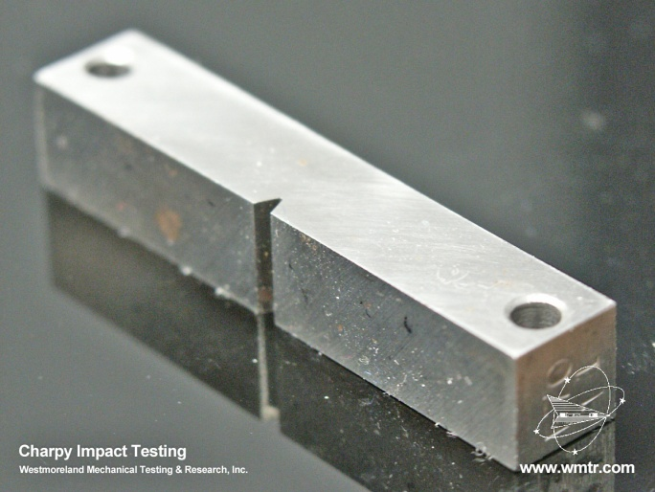
Dr.Suha K. Shihab
Notch toughness: represents the ability of a material to absorb energy usually determined under impact loading in the presence of a notch.

Slide 3
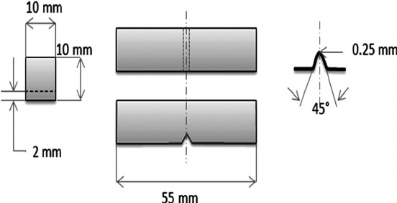
Charpy impact test
Dr.Suha K. Shihab
Types of impact test:
a) Charpy impact test
b) Izod impact test
Strikes form higher position with 300 Joules.
Test specimen is held horizontally.
The Charpy test sample has 10x10x55 mm³ dimensions, a 45º V notch of 2 mm depth and a 0.25 mm
Notch faces away from striker.
Izod test
Strikes at 167 Joules.
Test specimen is held vertically.
The Standard Size of I zod Impact test Specimen is (64mm x 12.7mm x 3.2mm) . The V notch Shaped bar is also used .
Notch faces striker.

Slide 4
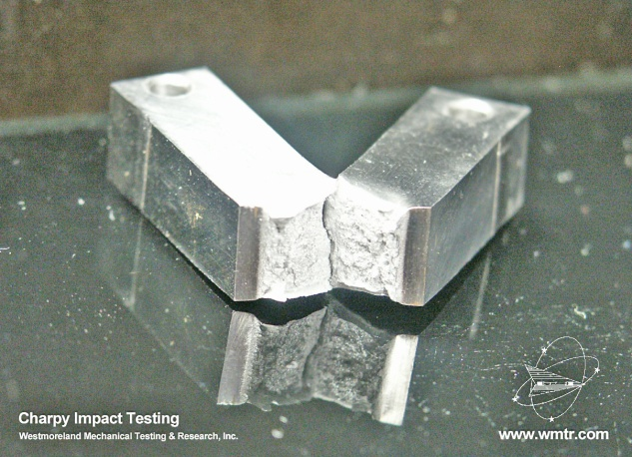
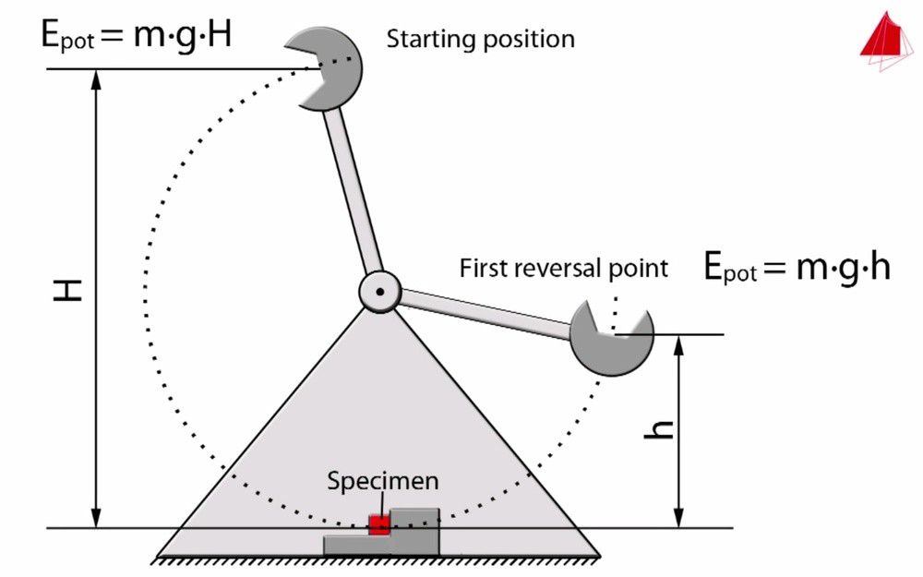
Dr.Suha K. Shihab
The energy absorbed is the difference in height between initial and final position of the hammer. The material fractures at the notch and the structure of the cracked surface will help indicate whether it was a brittle or ductile fracture.
Impact energy = mgH-mgh ;
Where,
m=mass of pendulum.
g=acceleration due to gravity.=9.81ms⁻²
The absorb energy in Joule Unit.

Slide 5
Fracture
Fracture : defined as the mechanical separation of a solid owing to the application of stress.
Fracture toughness : is a property which describes the ability of a material containing a crack to resist fracture, and is one of the most important properties of any material for many design applications. In addition, it is an indication of the amount of stress required to propagate a pre-existing flaw. It is a very important material property since the occurrence of flaws is not completely avoidable in the processing, fabrication, or service of a material/component. Flaws may appear as cracks, voids, metallurgical inclusions, weld defects, design discontinuities, or some combination thereof
Fracture behavior depends on many external factors:
Strain rate
Temperature
Stress rate
Types of Fracture
Ductile fracture
Brittle fracture
Inter-crystalline
Fatigue fracture
Brittle Fracture
There are three main factors influencing brittle fracture in materials
triaxial state of stresses,
low temperature application and
high strain rate or rapid rate of loading.
5

Slide 6
Ductile to Brittle Transition
The FCC alloys→ generally ductile fracture mode
The BCC alloys→ generally brittle fracture mode

Slide 7
Dr.Suha K. Shihab
Ductile to Brittle Transition Temperatures
As temperature decreases a ductile material can become brittle - ductile-to-brittle transition
The transition temperature is the temperature at which a material changes from ductile-to-brittle behavior
The results of impact tests are absorbed energy, usually as a function of temperature. The ABSORBED ENERGY vs. TEMPERATURE curves for many materials will show a sharp decrease when the temperature is lowered to some point. This point is called the ductile to brittle transition temperature (relatively narrow temperature range) . A typical ductile to brittle transition as a function of temperature.

Slide 8
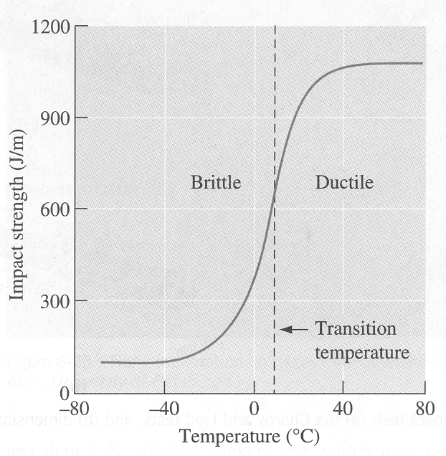
Dr.Suha K. Shihab
Figure 1: Energy absorbed by the test specimen as a function of test temperature

Slide 9
Dr.Suha K. Shihab
2
2
3

Slide 10
Dr.Suha K. Shihab
Cleavage : The tendency of certain minerals to break along distinct planes in their crystal structures where the bonds are weakest

Slide 11
Dr.Suha K. Shihab
Figure 3: Fracture surfaces at different temperatures

Slide 12
Dr.Suha K. Shihab
Effect Of Variables On Impact Energy
Metallurgical Factors Affecting Transition Temperature

Slide 13
Alloying usually shifts the ductile-to-brittle transition temperature
Carbon content increases the brittleness
Manganese content decreases the brittleness

